Slide 1
DABT Study Group
9/8/2017
2015 Recert Part C V1
Questions 9-16

Slide 2
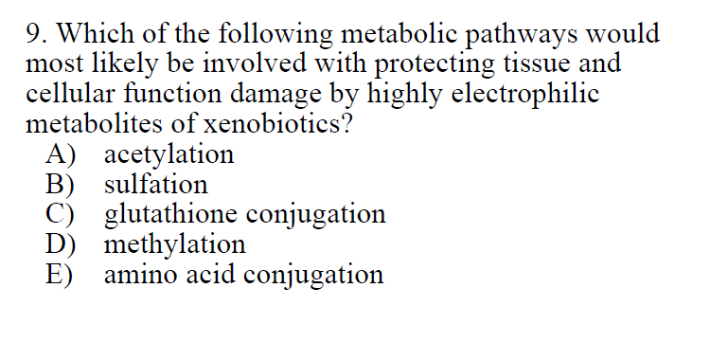

Slide 3
A) Metabolism related to chemicals containing an aromatic amine or a hydrazine
B) Metabolism related to nucleophiles
C) Correct – Ch. 3 Mechanisms of Toxicity (p. 25 Essentials)
D) Metabolism related to nucleophiles
E) Metabolism related to chemicals lacking functional group (Benzene, Toluene)

Slide 4
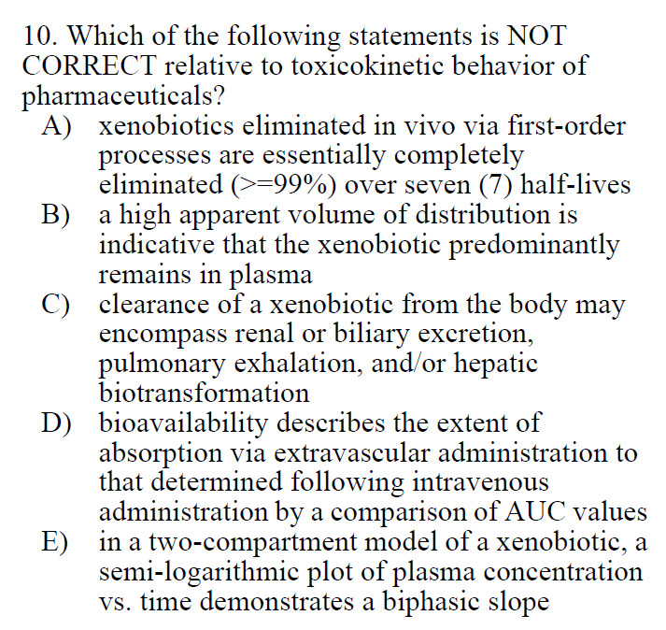

Slide 5
A) 100, 50, 25, 12.5, 6.25, 3.12, 1.56
B) False – would = low Vd
Ch. 5 Absorption…., p71 Essentials
C) True
D) True
E) True
Ch. 7 – TK, p111 Essentials

Slide 6
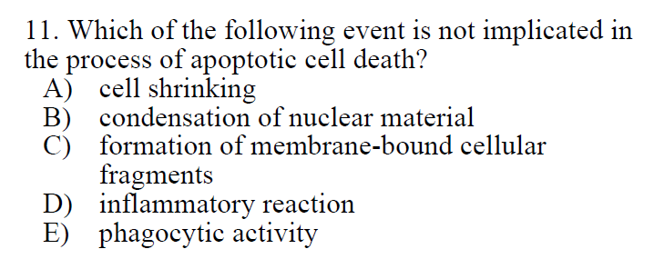

Slide 7
A) True
B) True
C) True
D) False
E) True
Characteristics of apoptosis outlined in Ch 3 – Mechanisms of Toxicity, p36-28 Essentials

Slide 8
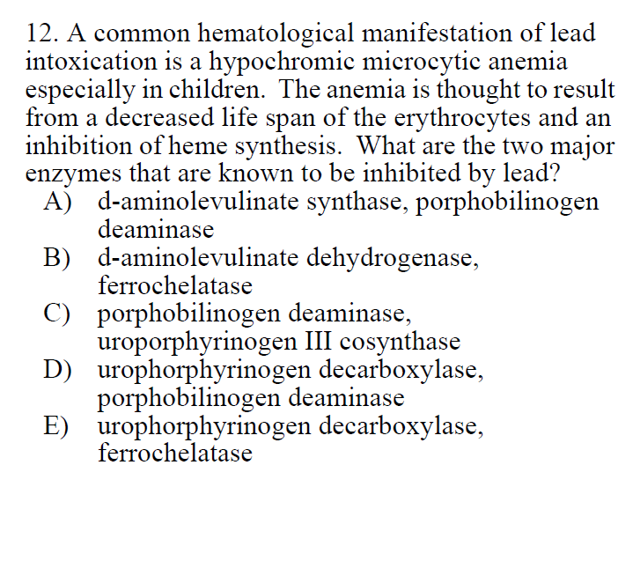

Slide 9
Chapter 23 (Metals) p994-5 8th Ed C&D
delta-aminolevulinic acid dehydratase (ALAD) and ferrochelatase are inhibited by lead
Other options not implicated to be inhibited by lead

Slide 10
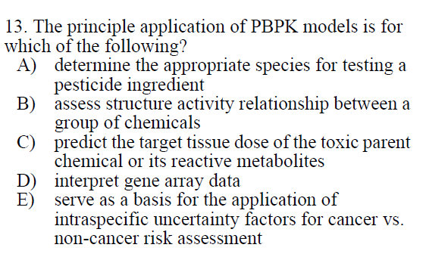

Slide 11
A) Not related
B) Not related (QSAR)
C) Best answer
D) Not primarily related to PBPK models
E) Not related

Slide 12
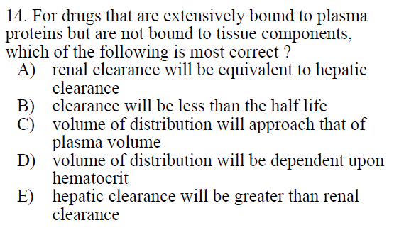

Slide 13
Eliminate A, B, E
Clearance for each organ related to blood perfusion flow of that organ and fraction of toxicant in arterial inflow that is irreversibly removed
Ch 7 TK, p 112 Essentials
Differences in toxicant metabolism need to be considered
C) Best answer - Vd is dependent on volume of liquid for that compartment. Plasma in this example.
Ch 5. p168-9 (C&D 8th ed)
D) Vd is dependent on volume of liquid for that compartment
Hematocrit - volume of red blood cells / total volume of blood

Slide 14
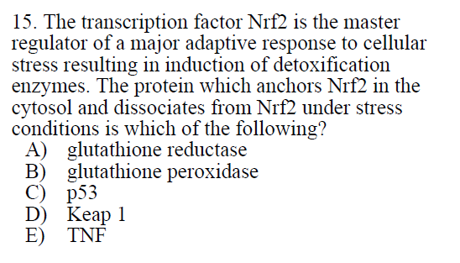

Slide 15
A) an enzyme (GSH reduction)
B) an enzyme (superoxide anion radical detox)
Ch 3 Mechanisms, p25-26 Essentials
C) TF related to cell cycle, DNA repair, apoptosis
D) Correct
KEAP1 sequesters NRF2 in cytoplasm and fascilitates degradation through ubiquitination by Cullin 3
Oxidative/Electrophilic stress alter cysteines in KEAP1 allowing for cytoplasmic NRF2 accumulation and translocation to nucleus (Wiki)
E) Inflammatory cytokine

Slide 16
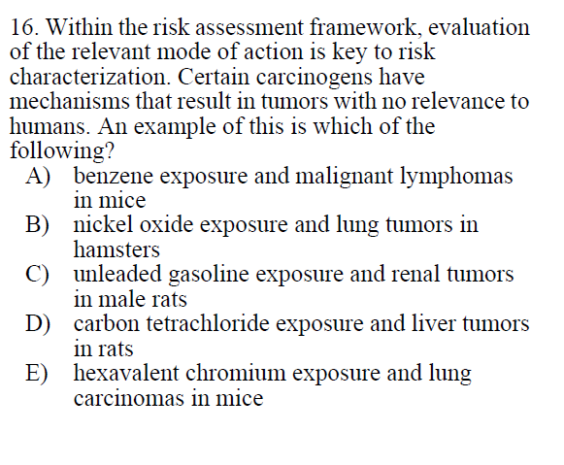

Slide 17
α_{2u}-globulin Nephropathy
Unleaded gasoline, D-limonene, 1,4-dichlorobenzene, decalin, tetrachloroethylene, and lindane
Bind to α_{2u}-globulin in male rats and prevent its breakdown
Not relevant to humans
Humans do not synthesize α_{2u}-globulin
humans secrete less low-MW proteins in urine and those present are not structurally related to α_{2u}-globulin
Chapter 14: Toxic Responses of the Kidneys (p 219 Essentials)

